Slide 1
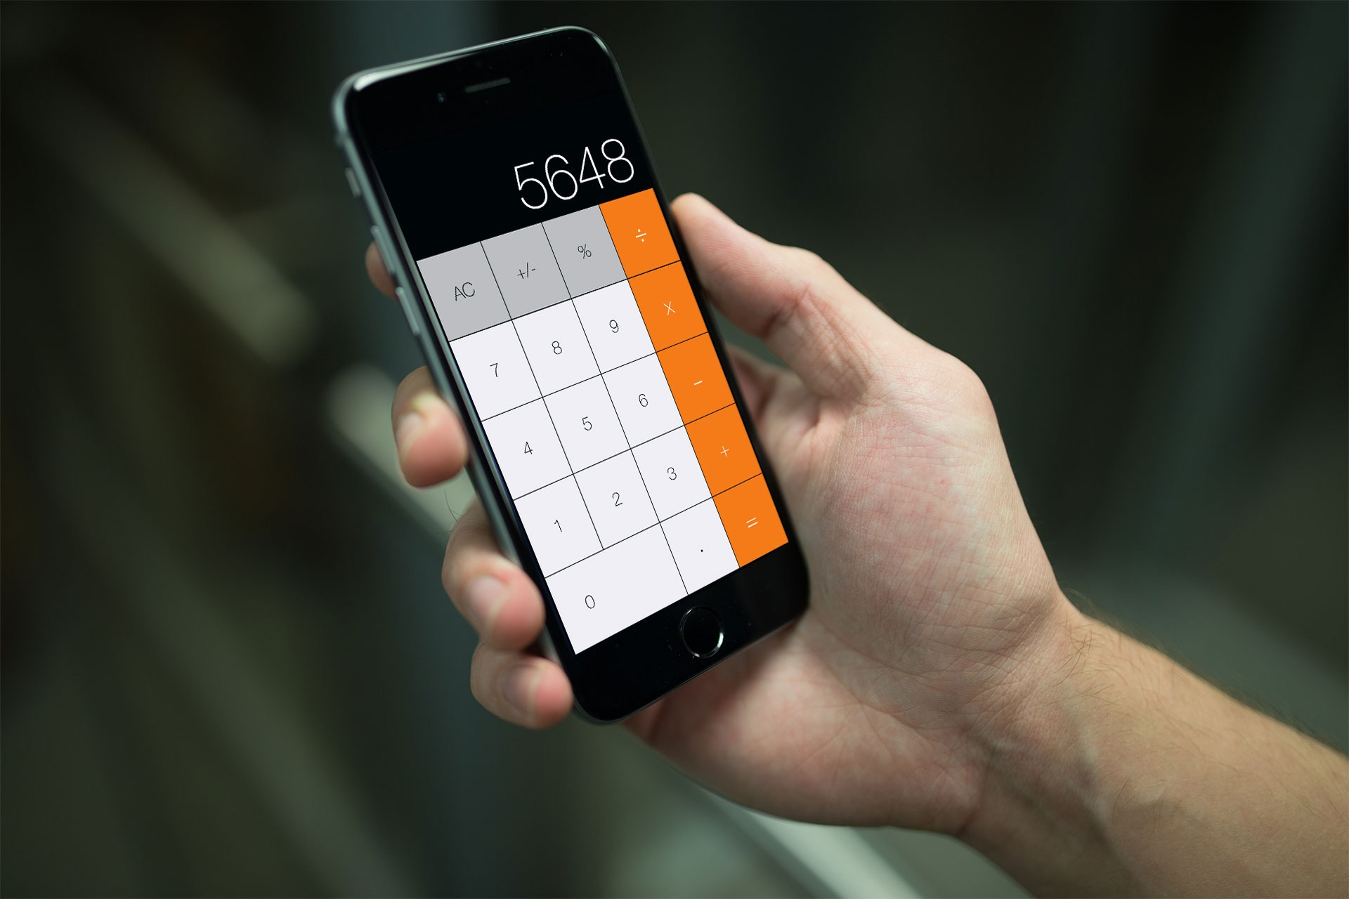
Keeping track of values in your calculator
by: Ali Younis
Rob Wyant
Andre Shonubi

Slide 2
Methodology
Use of two variables to store values, one variable to store Operation symbol, and one bool to determine if the user is typing or not
Use of our “special sauce”-- a function to turn string inputs to double values.
Use of currentTitle
var firstNumber = 0.0
var secondNumber = 0.0
var symbolForCalculation = “”
var userIsInTheMiddleOfTypingANumber = false
var displayValue: Double {
get {
return NSNumberFormatter().numberFromString
(calcDisplay.text!)!.doubleValue
} set {
calcDisplay.text = "\(newValue)"
}
}
sender.currentTitle!

Slide 3
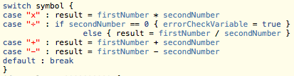
Workflow
Start with blank calculator
--User Is Typing (if statement)
--Append Digit (method)
Press Operator Button
--Convert Display (method)
--Assign First Number, Second
Number, and Symbol (var)
--Calculate Operation (method)
--User Is Typing (if statement)

